Slide 1
Getting started: Workshop on Vaccine Evaluation
Create a free account on the Rstudio Cloud: https://rstudio.cloud/
** Please do this even if you already have Rstudio installed on your computer!
2) Join the Workspace titled “xxxx”
3) Open the folder “Session 0 Intro to R”
4) Double click on the .rproj file
4) Open the “Intro to R English.Rmd” or “Intro to R Spanish.Rmd” file
5) Click the “Run document” button near the top of the screen
6) Follow the tutorial

Slide 2
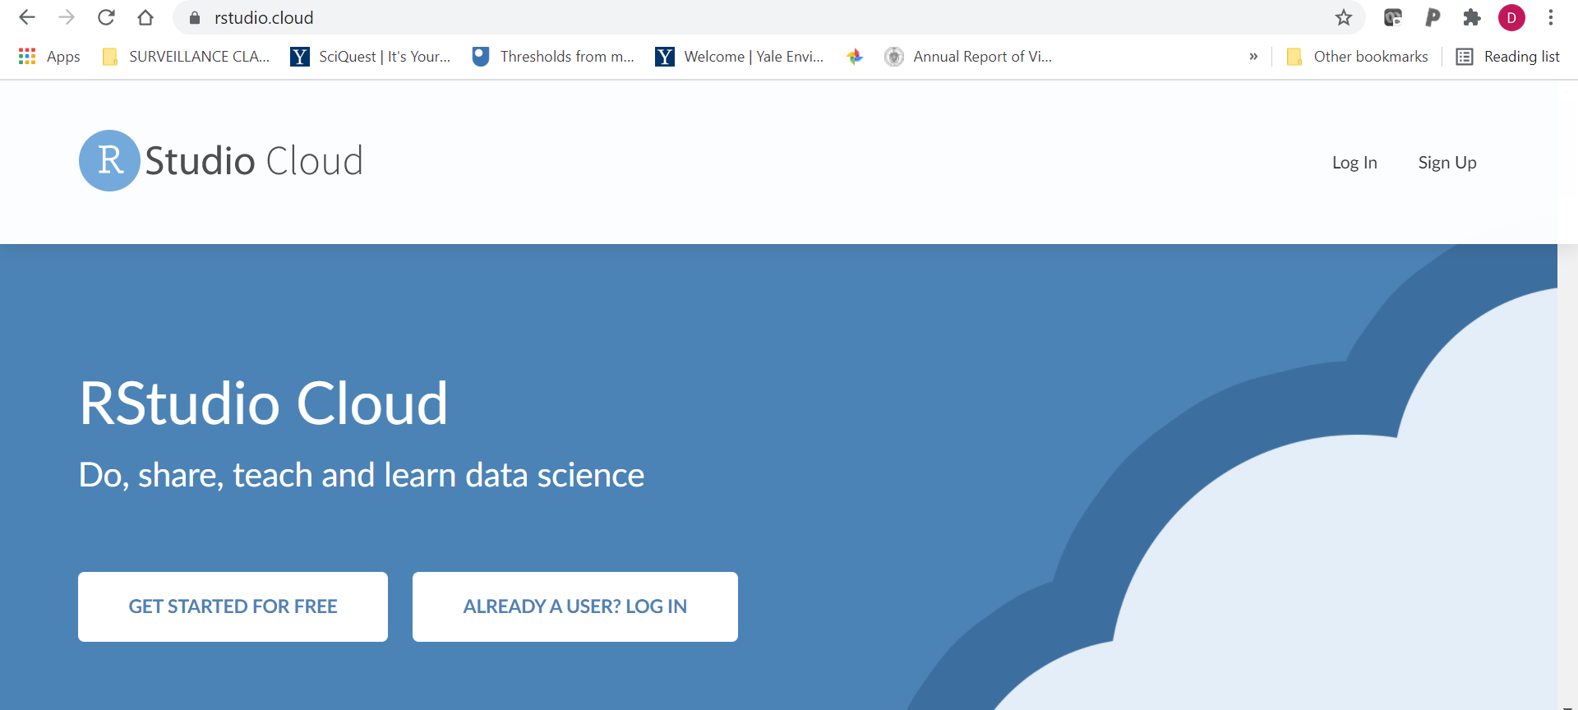
Step 1: Create a free account on the Rstudio Cloud: https://rstudio.cloud/

Slide 3
2) Join the Workspace titled “xxxx”

Slide 4
dropbox link for materials
https://www.dropbox.com/home/PAHO%20mortality/Workshop%20May%202019

